Slide 1
BTMW 4012 TECHNOLOGY ENTREPRENEURSHIP Lecture 2: Business Opportunities: Ideation & SEO
FPTT - UTeM

Slide 2
Introduction
An idea can be regarded as the outcome of a thinking process (i.e impression, opinion, view, belief, formulation and concept). In entrepreneurship, ideation is the creative process of generating, developing, and communicating new ideas.
A business start-up ideation must be centred on solving customers’ problems.

Slide 3
Idea Generation
Generating an idea may involve the whole process of observing, thinking (analyzing), communicating (discussing) and developing, which can be abstract, concrete and visual.
Ideas may come to entrepreneurs from daily exposures. A frustrating experience or a source of irritation could be a great business idea for an entrepreneur. Customers’ complaints and feedback can provide an opportunity to develop something better, quicker or cheaper than existing products.

Slide 4
Ideas from Work Experience, Hobbies, Interests and the Environment
Work experience is one of the primary sources of a business idea (Strydon, 2007). An entrepreneur can use his work experience and technical skills obtained from earlier work to resolve problems and shortcomings in his present work or operation system.

Slide 5
Ideas from Work Experience, Hobbies, Interests and the Environment (cont.)
A new business idea may grow from a hobby or personal interest.
For example, someone who loves to bake cakes may start selling their cakes online as a way to generate income. This business may grow as demand increases. The home baker will need to decide at one point whether to become an entrepreneur managing a growing business, or he may return to baking just as a hobby.

Slide 6
Ideas from Work Experience, Hobbies, Interests and the Environment (cont.)
New ideas, information, opportunities or insight into new technological trends may reach entrepreneurs through trade exhibitions, or links with universities and research institutes, or networking with sales representatives, wholesalers, distributors, manufacturers, franchisers, professors and research scientists.
It is also important to observe and pay attention to latest trends and technological development in technical magazines, scholarly journals, newspapers and the Internet.

Slide 7
Ideas from Work Experience, Hobbies, Interests and the Environment (cont.)
A clever entrepreneur will likely systematically scan his environment to identify business ideas or to get an idea on the problems faced by the people and explore possibilities of offering products or services that may solve such problems.
Biallas (2014) shows the matrix of business idea (existing and new) versus market (existing and new market) in Figure 10.1. There are four quadrants that may be analyzed to identify new ideas.

Slide 8
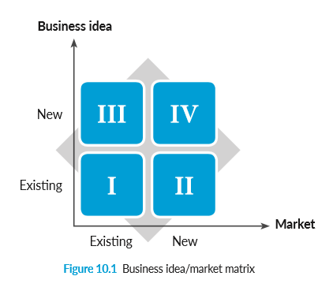
Ideas from Work Experience, Hobbies, Interests and the Environment (cont.)
Examle of:
Existing business idea /
Existing Market
2. New business

Slide 9
Ideas from Work Experience, Hobbies, Interests and the Environment (cont.)
Discuss possible example of:
Q1⎯Existing business idea / Existing market: Offering existing product and /or service to existing market.
Q2⎯Existing business idea / New market: Offering existing product or service to new market.
Q3⎯New business idea / Existing market: Offering new product and / or service to existing market.
Q4⎯New business idea / New market: Offering new product and / or service to new market.

Slide 10
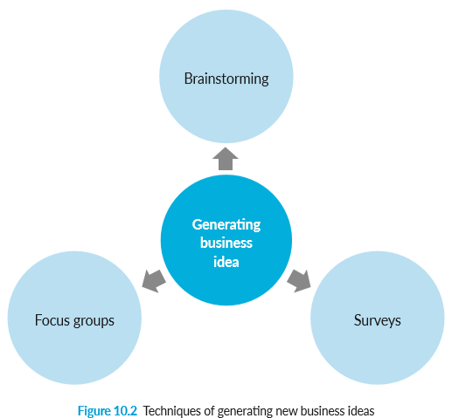
Techniques for Generating new Business Ideas
There are many ways
to help entrepreneurs generate a new
business idea.

Slide 11
Brainstorming
Brainstorming is one of the most commonly used techniques in generating a new business idea. The aim is to come up with as many ideas as possible in a short period of time. Usually questioning or criticism is not allowed.
People do not need to fear making mistakes or looking foolish in front of other team members. In fact, it is highly encouraged to put forward ideas which might not seem to work. There are no “bad” ideas, as all ideas could be the start for another idea. It is also good to have a multidisciplinary team so that a problem can be approached from different perspectives.

Slide 12
Focus Group
A focus group is typically composed of eight to 14 individuals participating in a discussion to generate a new business idea in a structured way.
The focus group members are usually selected because of their relationship with the issue being discussed.
A trained moderator leads the group through an open and in­-depth discussion, in either a directive or non­directive manner. The success of the session is highly dependent on the moderator’s ability to ask questions that keep the discussion on track.

Slide 13
Surveys
A survey is a technique of collecting valuable information from a sample of people; usually just a fraction of the population being studied.
Demand, supply and change in customer behaviour can be analyzed and ascertained through a survey.
The survey can be carried out formally or informally via various methods: interviews, questionnaires or observations. The survey usually asks specific questions and gets specific answers, which helps entrepreneurs to generate new business ideas.

Slide 14
Transformation of Ideas into Business Opportunities
In order to get an idea on the business potential of the new ideas, entrepreneurs may ask the following:
Has it solved the customers’ problem or pain?
Does it offer higher value ­added products or services?
Does it have a unique selling proposition?
Can it be produced at an acceptable cost, and marketed and sold at a profit?
Does it have competitive advantage compared to competitors’ products?

Slide 15

WHEN IS AN IDEA AN OPPORTUNITY?
Solve a problem
Create/add value
Robust market/profit margin

Slide 16
Business Opportunities through Buying of Existing Business
Business opportunities can also be in the form of existing business being offered for sale at attractive price with good business potential. However, a detailed due diligent evaluation must be done on the business for sale to make sure that the offer price is competitive and the business potential is attractive.

Slide 17
Attractive
Timely
QUALITIES OF OPPORTUNITY
Durable
Anchor to create value

Slide 18



HOW TO IDENTIFY OPPORTUNITY???
What is the customer pain???
Notes:
Solve a problem -

Slide 19

WHAT DOES IT TAKE TO HAVE A SUCCESSFUL NEW BUSINESS?
People
People
People

Slide 20
QUANTIFYING PAIN
Market Type
Business
Decreased Expenses
Increased Revenue
Time Savings
Consumer
Convenience
Entertainment
Time or Dollar Savings

Slide 21
WHY PAIN IS CRITICAL (ESPECIALLY FOR TECH START-UPS)
Conserve resources
Makes raising money easier
Reach breakeven sooner
Allows company employees to focus
Know what expertise is needed in employees

Slide 22
WHAT HAPPENS WITHOUT PAIN
Without
Clear & Present
Pain
Hire People With Wrong Skills
Pursue Multiple Markets & Opportunities
Spend More Money
Than Planned
Behind Schedule &
Over Budget

Slide 23
WHY PEOPLE (NOT PAIN) GET SO MUCH CREDIT . . .
Venture focus changes, this is normal – Early-Stage Tech Start-ups
Flounder
New management identifies the pain and addresses it
Conclusion: “People” was the key to success.
Really: Focusing on a customer pain was the key.

Slide 24
Lets take a look to ONE example of
PHOTOGRAPHERS’ PROBLEMS

Slide 25
THINK OF PHOTOGRAPHERS’ PROBLEMS
Finding a good model.
Getting right pose from a model
Getting models to pay attention
Finding the right backdrop
Eliminating hot spots on backdrops
Setting up correct lighting
Etc, etc., etc.

Slide 26

THINK OF PROBLEMS PHOTOGRAPHERS HAVE WHEN . . .
Finding the right backdrop

Slide 27
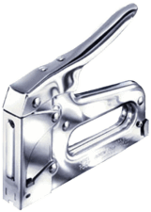
ASSEMBLING THE BACKDROP
Push Here
Arrow T50
Staple Exit

Slide 28
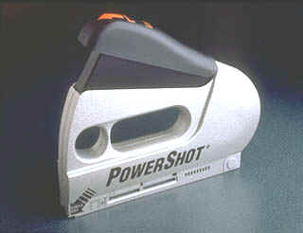
PRODUCT DESIGN OPPORTUNITY
Push Here
Push Here
Arrow T50

Slide 29






Slide 30






Slide 31
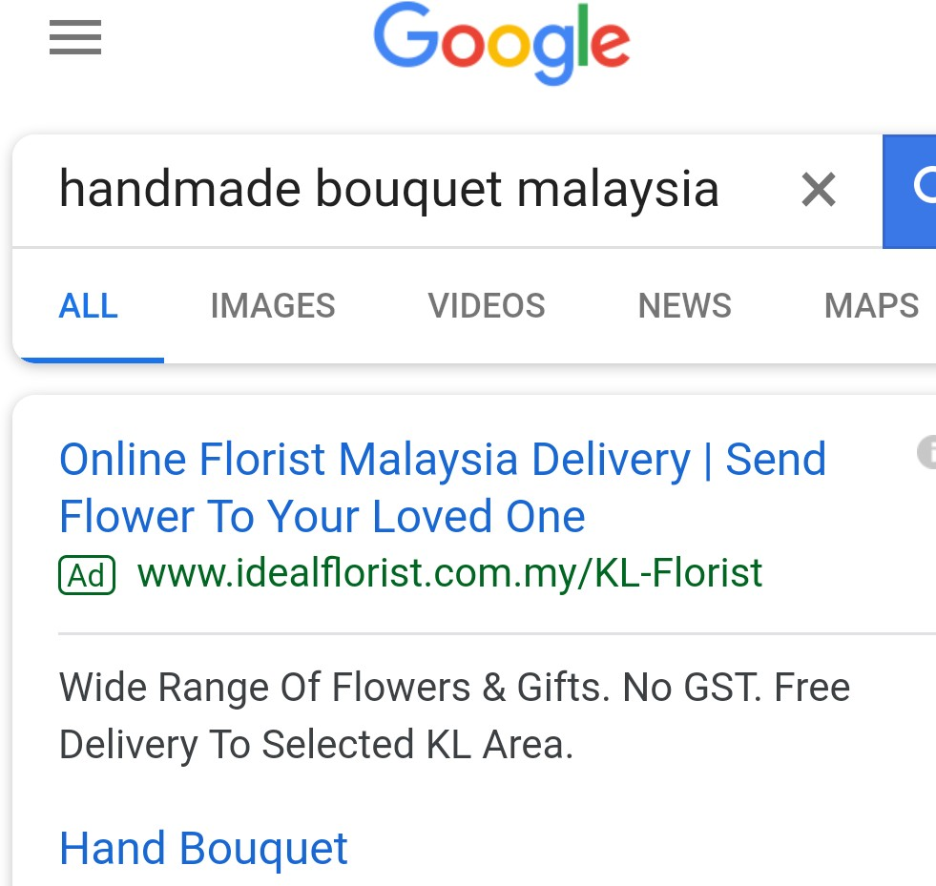

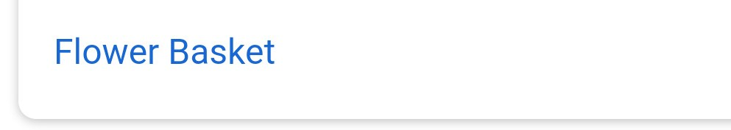
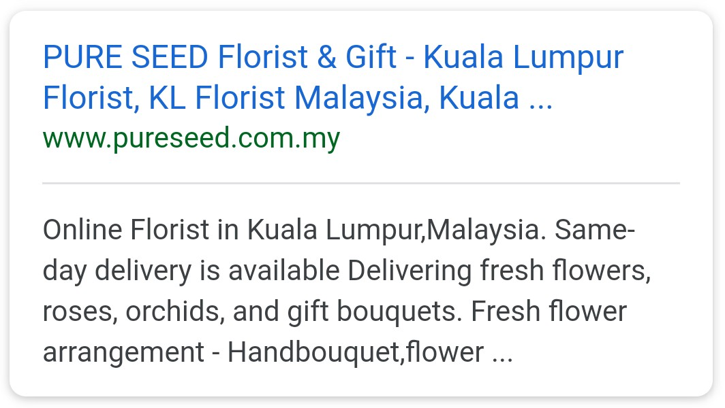

Slide 33

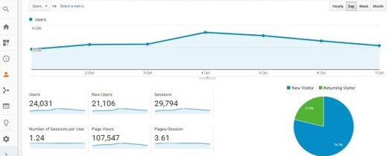

Slide 34








Slide 35
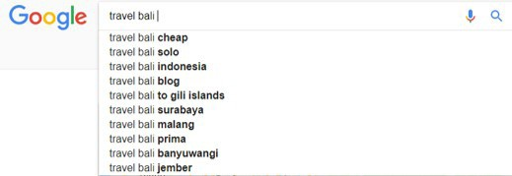

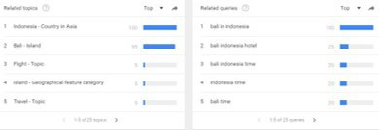
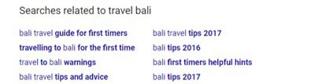

Slide 36





Slide 37
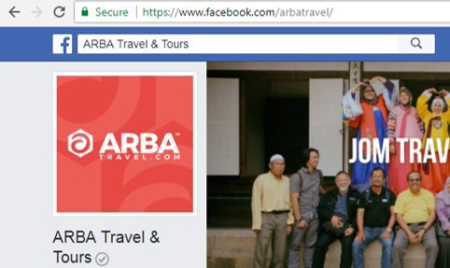

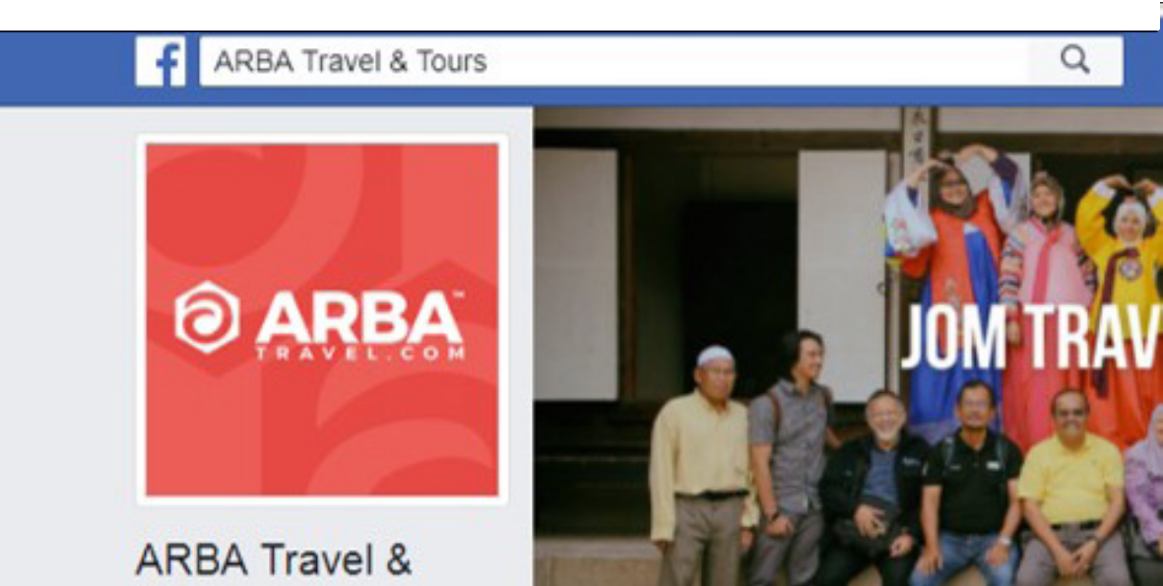


Slide 38
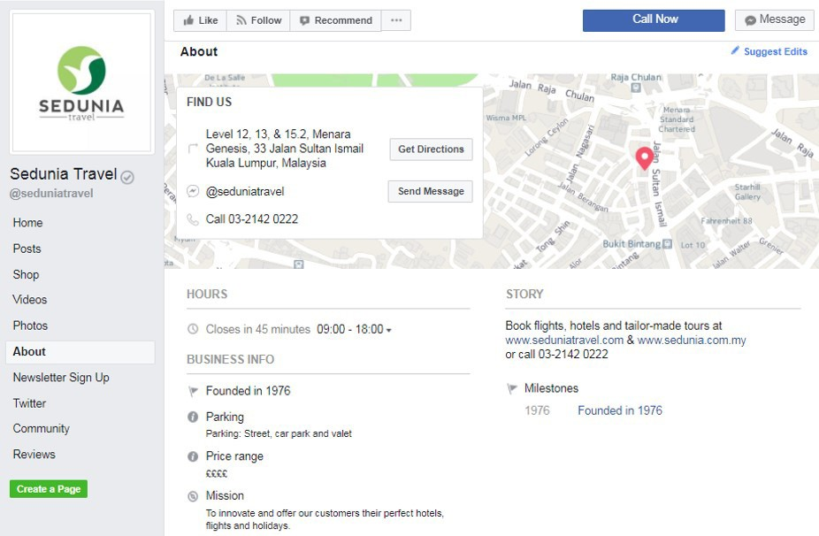
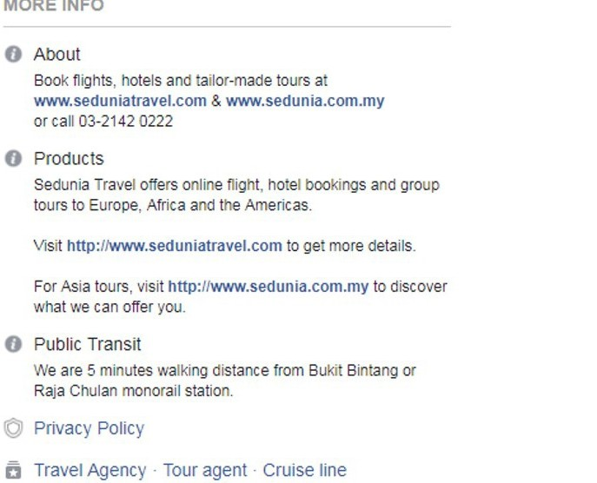

Slide 39






E

Slide 40
The End

